Slide 1
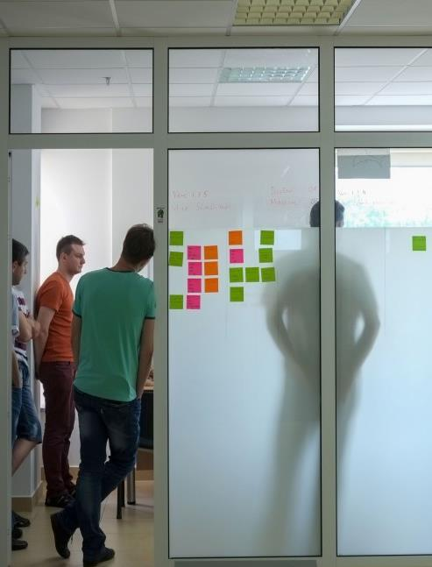
Optimising BA deliverables
22-05-2023

Slide 2
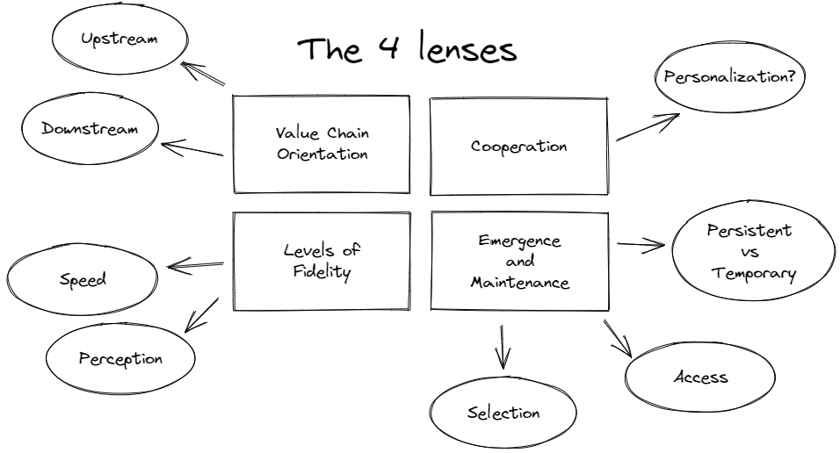
In this talk
1.
Existential dread
Asking the right questions yield good answers, how can they lead to action and improvement?
2.
Value chain orientation
Where are you, and what are you doing there?
3.
Cooperation
Who are we doing all this for/with anyway?
4.
Levels of Fidelity
What does it take for people to see what’s in front of them?
5.
Emergence and maintenance
What do you pick if you have to choose? Who’s allowed to do anything with it?

Slide 3
How can you tell if what you’re doing is having a positive effect on the organisation?
“Is what I’m doing actually working?”
Notes:
Metrics:
Improved business outcome
Stakeholder feedback
Reduced risk (by identifying new risks, there’s no value in affirming risk)
Improved decision-making
Increased adoption of solutions

Slide 4
Improved business outcome
Stakeholder feedback
Reduced risks
Improved decision-making
Increased adoption of solutions
Notes:
Complexity
Irrelevance
Lack of stakeholder engagement
Poorly defines requirements
Lack of follow-up

Slide 5
What really doesn’t work?
Notes:
Complexity
Irrelevance
Lack of stakeholder engagement
Poorly defines requirements
Lack of follow-up

Slide 6
Complexity
Irrelevance
Lack of stakeholder engagement
Poorly defines requirements
Lack of follow-up

Slide 7
Let us discover together what tools we can use to evaluate what we create.
Notes:
Metrics:
Improved business outcome
Stakeholder feedback
Reduced risk (by identifying new risks, there’s no value in affirming risk)
Improved decision-making
Increased adoption of solutions

Slide 9
Value Chain Orientation
The characteristics of BA deliverables are very different depending on where in the value delivery process they fit in:
Creating a deliverable that describes an idea is different from a deliverable that describes a piece of work that must be done.
If you’re not sure, make something that’s at least accessible and easy to understand.

Slide 10
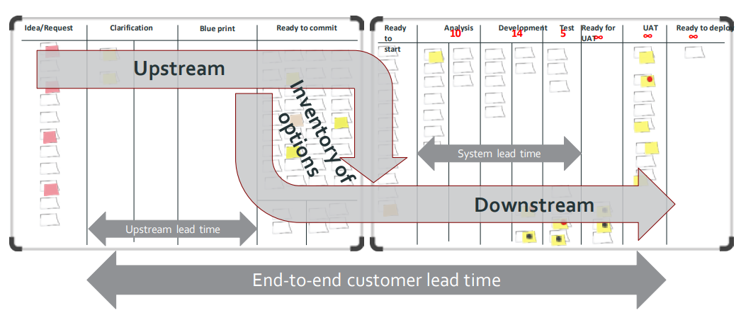
Notes:
Available for free at https://kanbanbooks.com/

Slide 11
Upstream
Downstream
Initiative
Decision
Delivery
Discover
Define
Develop
Deliver
Notes:
Commitment
Definition of ready
Design Thinking
Agile, Lean, loops etc. they all have iterations in common, they appear to be circular concept yet the time in which our projects live remains very linear still.

Slide 12
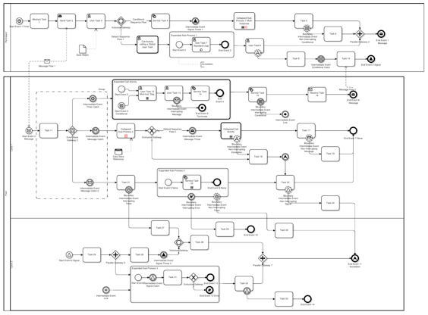
💡 You need to know BPMN to understand this

Slide 13
As [a user persona], I want [to perform this action] so that [I can accomplish this goal].

Slide 14
Let’s abuse the user story format
as much as we possible can!

Slide 15
You learn what doesn’t work much faster than what does werk.

Slide 16
Socrates and his daemon
Notes:
Socrates had a daemon, a voice that told him what not to do.

Slide 17
“Experience is something you don't get until just after you need it.”
- Steven Wright (American comedian)

Slide 19
Cooperation
BA deliverables should support cooperation and encourage people to take ownership.
Favor making deliverables that facilitate cooperation over deliverables that cater to a specific person.
Making your deliverables accessible and understandable to a wider public is valuable because it creates options.

Slide 20
Meet Tony

Slide 21
Tony is the rockstar in your team

Slide 22
Do any of you know a Tony?

Slide 23
As an admin, I want to do that thing we did the other time so that the thingy works.
Notes:
Tony will understand, but will the rest of your team?

Slide 25
Hi Tony!

Slide 26
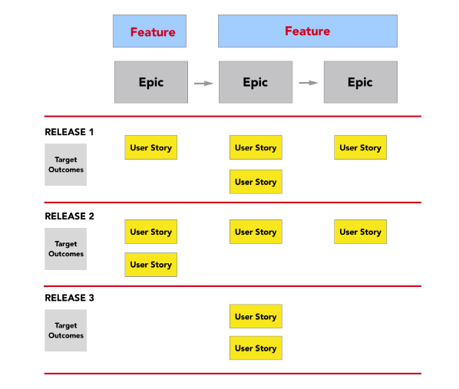
A good example
Notes:
https://openclassrooms.com/en/courses/4544631-learn-the-fundamentals-of-agile-estimation/5222896-plan-releases-using-story-maps

Slide 28
Levels of fidelity
Match the level of detail in your deliverable to the task at hand.
There is no perception without embodiment. Some people need a few lines, some need a detailed picture.
Favor a low-resolution model over a high-resolution model and iterate to build trust. Increase the level of detail along the way to lock in what has been agreed upon.
Be mindful of the amount of work you put into a model. Something that takes long to make usually takes a long time to change.

Slide 29
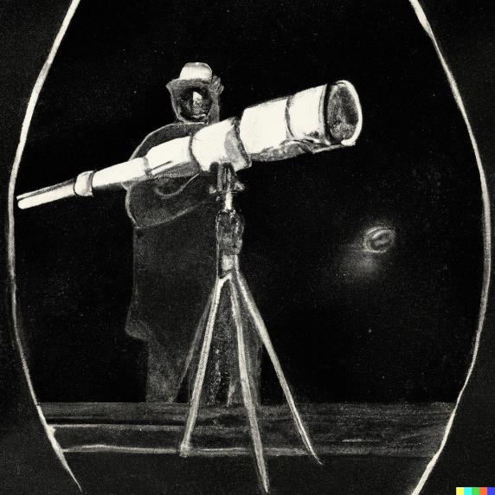
Where does scope creep come from?

Slide 30
Low fidelity

Slide 31
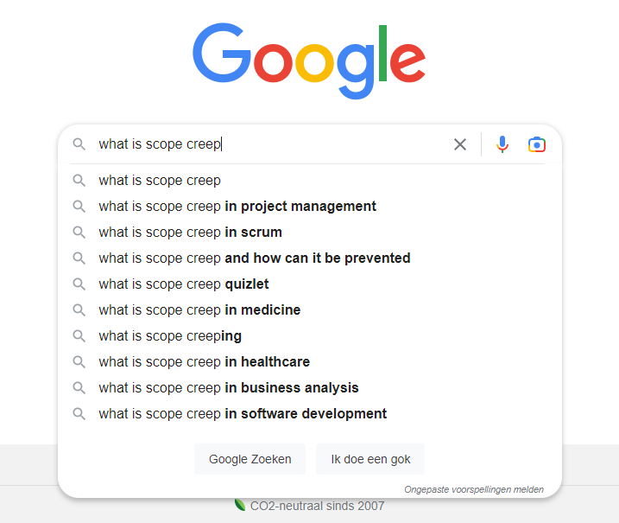
High fidelity

Slide 32
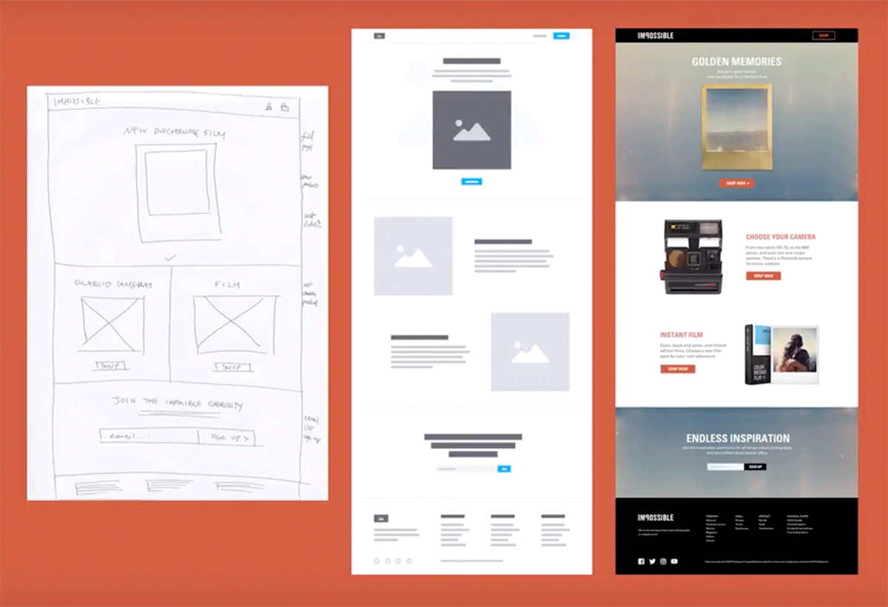

Slide 33
There is no perception without embodiment.

Slide 34
How can you properly balance?
Level of detail vs. speed
Notes:
JIT often pays off
Because detail is emergent

Slide 35
JIT (just in time) often pays off because detail is emergent …
Notes:
JIT often pays off
Because detail is emergent

Slide 37
Emergence and maintenance
Create a setting that motivates people to take ownership and maintain documentation.
Be mindful of what needs to be documented for a long time and what can be discarded after processing.
Put you work in a system where you and your colleagues can work together on it.
Discover what needs to be documented by listening to your users.

Slide 38
What kind of information do you need to get work done?
What kind of information do you need to get work done?

Slide 39
Briefing material
All the information that is needed for someone to perform the work correctly, in such a way that it supports the goal of the project and the organization.

Slide 40
Types of information to get work done
Persistent information
Temporary information
Documentation
Best practices
Conventions
Lessons learned
…
User stories
Tasks
Bugs
Support requests
…
Notes:
One goes into a tracker
The other one goes into a wiki

Slide 41
How do you select what to document?
Notes:
https://agilemanifesto.org/

Slide 42
How can we make documentation valuable?
Access
Permission
Ownership
Know-how

Slide 43
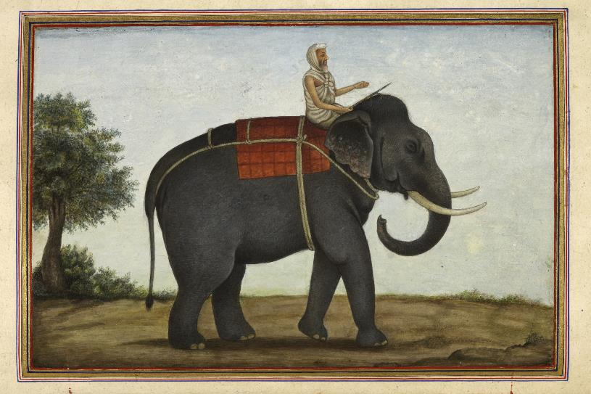
Notes:
Switch van Chip & Dan Heath
The Rider and The Elephant
Direct the rider (logos, the rational system)
Wees erg precies, geef de juiste richting aan
Wat soms lijkt op weerstand is vaak een gebrek aan duidelijkheid
Script de kritische bewegingen
Zoek naar positieve voorbeelden, de lichtpuntjes
Motivate the elephant (pathos, the emotional system)
Mensen moeten het geloven dat het kan
Breek de verandering in verteerbare stukken
Schep een identiteit
Shape the path
Mensen zijn het product van hun omgeving
Gewoontes zijn heel sterk
Kuddegedrag werk in 2 richtingen, laat mensen ownership nemen van een idee “”

Slide 44
The Rider and the Elephant
Direct the rider
Be very precise
Create scripts for the critical parts
Show examples
Motivate the elephant
People should believe it
Shape the work, make small bits
Create an identity
Shape the path
People are the product of their surroundings
Habits are very powerful
Allow ownership

Slide 45
Talk to us about the TBA academy info@thebusinessanalysts.be

Slide 46
Join our team!
Talk to any of us here at the conference, we’ll be here today and tomorrow.
Check out what we have to offer:
thebusinessanalysts.be

Slide 47
Thank you!
Let’s have a coffee

